Slide 1
MATLAB implementation of filtered backprojection reconstruction for optical projection tomography with center of rotation correction
GPU support included
Olli Koskela

Slide 2
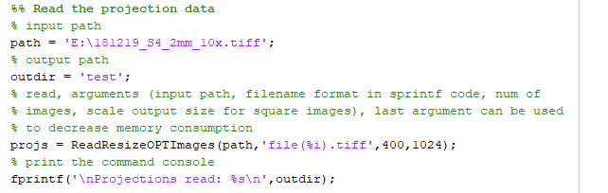
Step 1
Notes:
Set input and output paths, both are either absolute or relative to the working directory (i.e., not cross related).
The default assumes files are type file(1).tiff, where number runs from 1 to 400. The reading function can resizes the files while reading for less RAM computers.

Slide 3
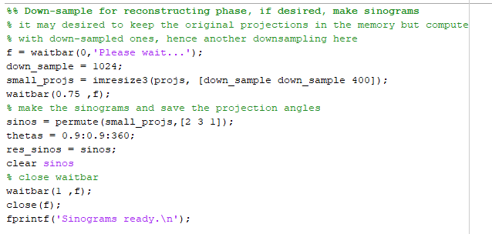
Step 2
Notes:
This part remaps the data into sinogram. The data can also be down-sampled in this section. Check that thetas comply with your images.

Slide 4
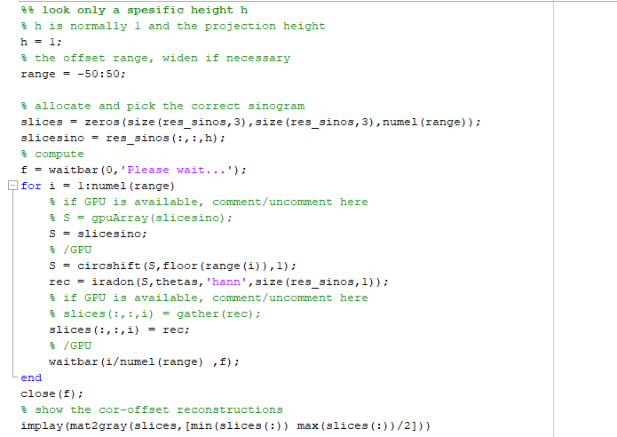
Step 3 a
Notes:
Third step is for searching the center of rotation, since there is most likely some offset between the projection image center and the true center of rotation. Reconstruction function assumes the center of the image data to be the center of rotation as well. Offset images are computed for given height h.

Slide 5
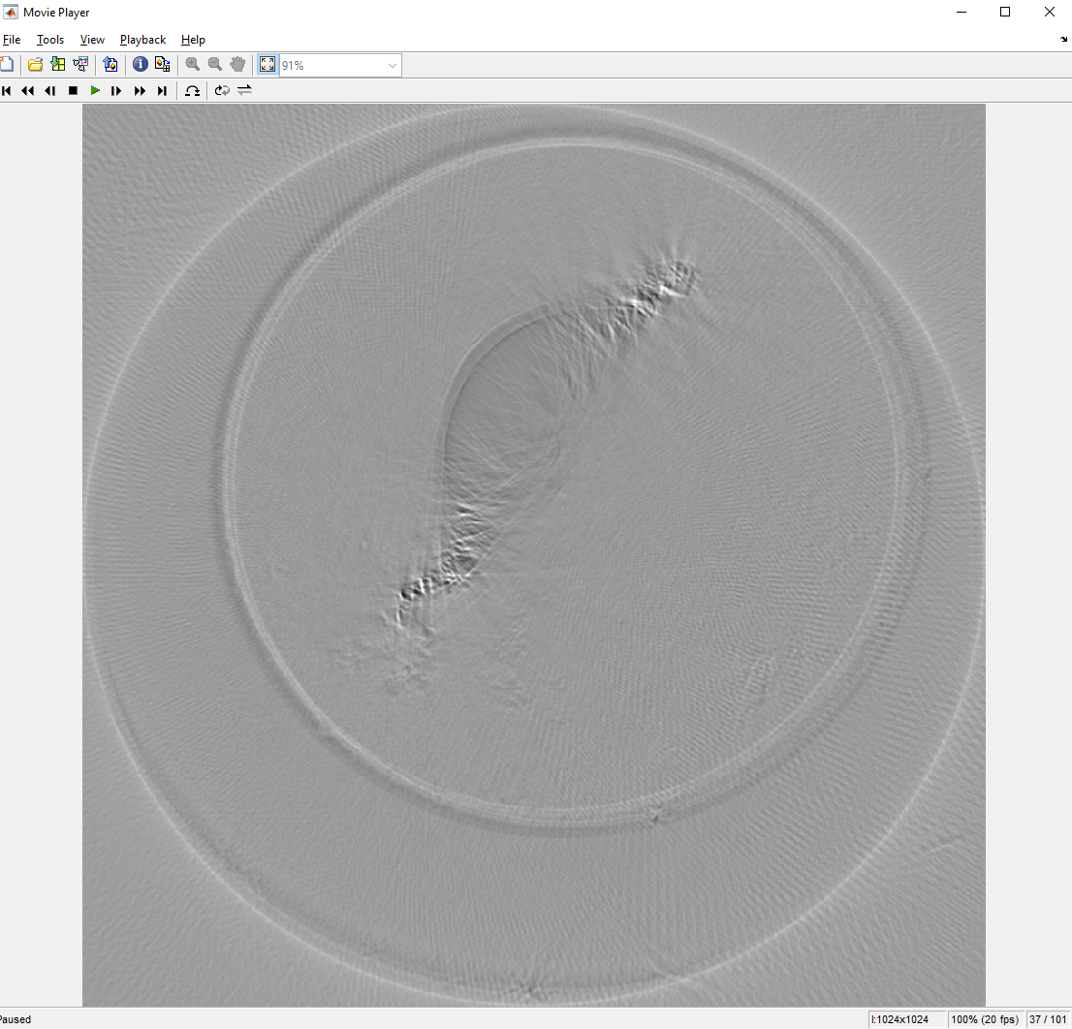
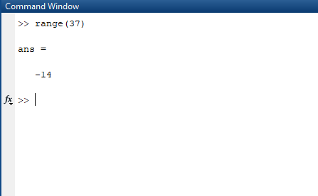
Step 3 b
Notes:
Once the cor offset reconstructions are complete, they are shown with imshow. Choose the correct offset index (shown on right bottom corner, 37 in this case) and the corresponding offset value is in the range-variable in that index.

Slide 6
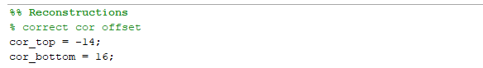
Step 3 c
Notes:
Save the CoR-value to respective variable; default being top for h=1 and bottom for h=projection image height.

Slide 7
Step 4
Repeat steps 3 for h=1024
h=1024 is the down-scaled size in this example, use the value the projections were down-scaled to.

Slide 8
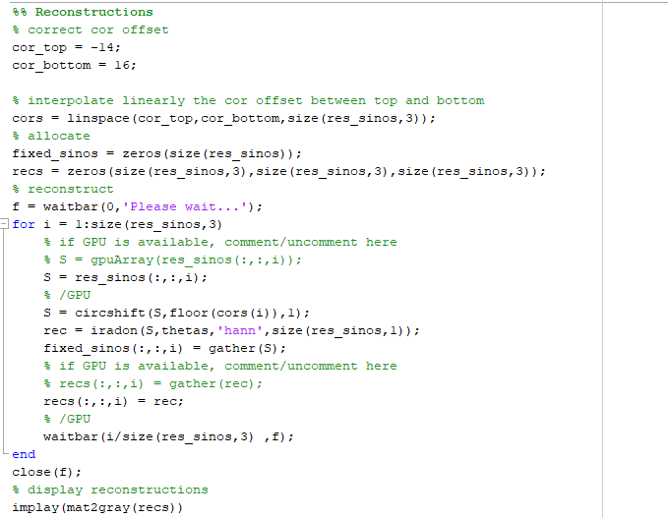
Step 5
Notes:
Once the offset values are set (cor_top and cor_bottom), run the reconstruction section.

Slide 9
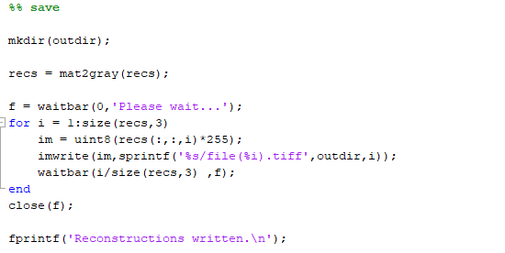
Step 6
Notes:
Save reconstructions in 8-bit tiff format. If 16-bit is desired, change 255-multiplicative to 65535. Reconstructions are saved to the output folder set in the first sections.

Slide 10
Heighted CoRs
Implementation when center of rotation offset can not be computed from top and bottom most slices
fbp_w_heighted_cors.m

Slide 11
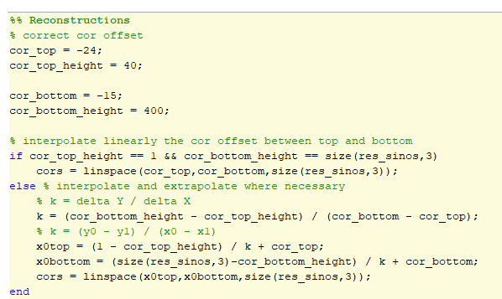
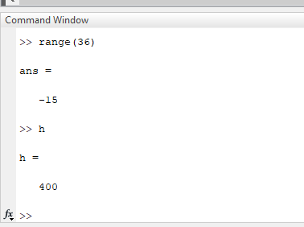
Steps 3 b - c
Notes:
In the case of heighted CoRs, both the actual CoR from range variable and the heighted h it was computed with needs to be saved to the Reconstructions section.
The if-else block now inter- and extrapolates the CoR values where necessary.
PLEASE NOTE, THAT FOR THE STABILITY OF THE SOLUTION, CORS SHOULD NEVERTHELESS BE COMPUTED AS FAR APART FROM EACH OTHER AS POSSIBLE. That is, from as close to tob and bottom as possible.
Otherwise the code works the same as described before.

